Slide 1

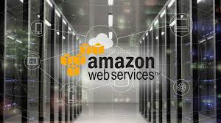
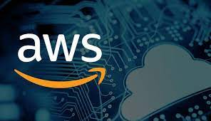
Building AWS Lambda Function Integrate With API Gateway

Slide 2
AWS (Amazon Web Service)
Amazon web service is an online platform that provides scalable and cost-effective cloud computing solutions.
Cloud computing is the on-demand availability of computer system resources, especially data storage and computing power, without directly management by the user.

Slide 3
Serverless Application
Serverless is a cloud-native development model that allows developers to build and run applications without having to manage servers.
There are still servers in serverless, but they are abstracted away from app development.
Developers can simply package their code in containers for deployment.

Slide 4
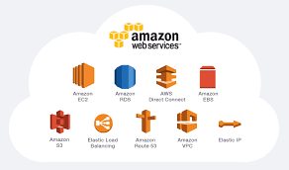
Some useful services to build Serverless Application
API Gateway
AWS Lambda
DynamoDb
IAM Roles , users
Cloudwatch

Slide 5
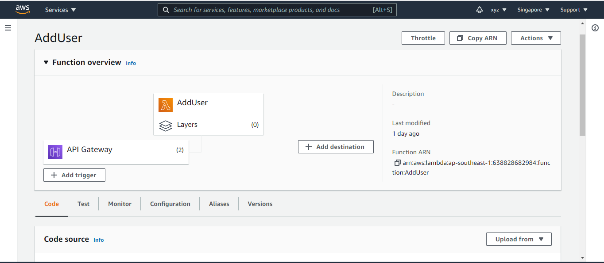
AWS Lambda
AWS Lambda is a serverless compute service
AWS Lambda is a Platform as a Service (PaaS). It helps you to run and execute your backend code.
It lets us run code without managing servers or managing runtimes.
Just pay for the consume time you use.
AWS Lambda natively supports Java, Go, PowerShell, Node. js, C#, Python, and ruby code, and provides a Runtime API.

Slide 6
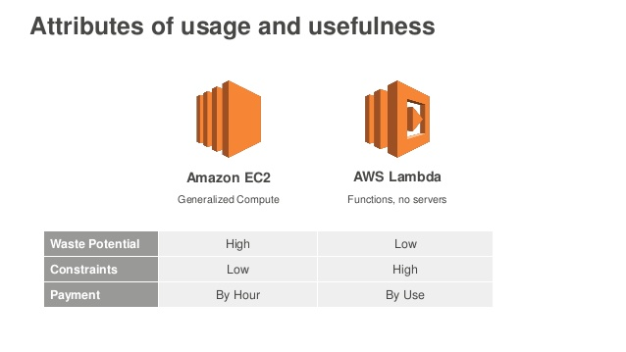
AWS Lambda When to use 1. You Only Pay for What You Use 2. You do not need to set up any Virtual Machine. 3. Executes AWS Lambda Code when it is triggered by AWS services
When not to use 1. AWS Lambda completely depended on AWS for the infrastructure; you cannot install anything additional software if your code demands it.
2. not suitable for small projects. 3. Continuously running and long running process 4. complex business logic with multiple transaction

Slide 7
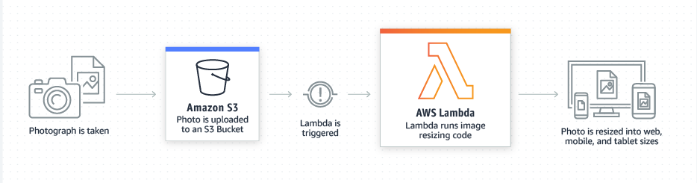
When to trigger Lambda function
Example of when to call lambda function -
Upload files in an S3 bucket
When HTTP get/post endpoint URL is hit
For adding/modifying and deleting Dynamo DB tables
Push notification
Email sending

Slide 8
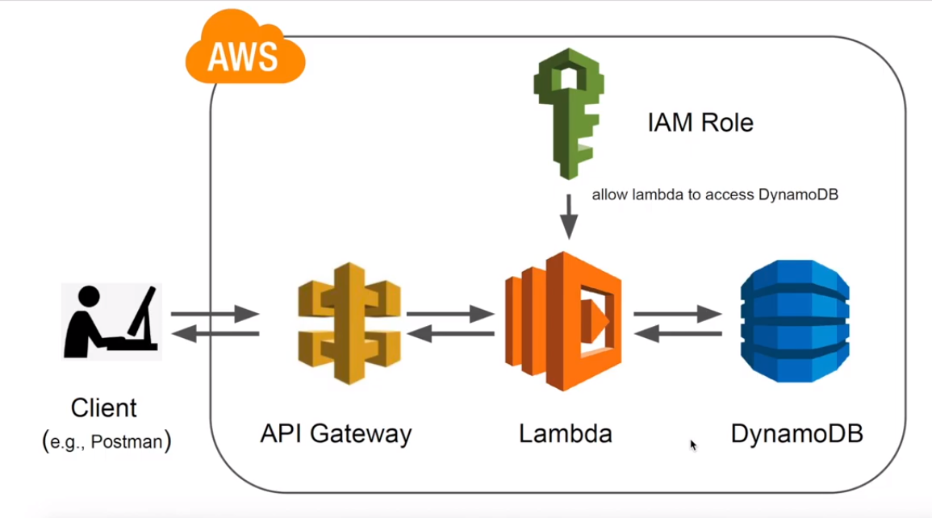
How lambda function works ?

Slide 9
Step by step approach to build AWS Lambda
1st session ->
Install AWS Toolkit in visual studio from Extensions.
Create a AWS Lambda Project and explain the project structure.
Create an IAM User with roles to get the access key id and secret key.
Add logger and Publish the Lambda project and test the function.
2nd session ->
API Gateway proxy request and response to handle request and response of REST API.
Explain & Create an table in Dynamo DB (No SQL Database )
Build a lambda function to Add & Get Items from a Dynamo DB table.
Create an API Gateway (build REST API ) and Integrate it with the lambda function.

Slide 10
References
DotNet Core Central best playlist : https://www.youtube.com/playlist?list=PLXCqSX1D2fd9rVux4a5y6krZQQOwMcWz2
How To Easily Get Started | AWS LAMBDA SERIES
https://www.youtube.com/watch?v=BbUmLRaxZG8
https://youtu.be/IHIJFVUQyFY
Build a Serverless Dotnet Core Web API with AWS Lambda and API Gateway
https://codingwithsam.com/posts/getting-started-.NET-AWS-lambda/
https://www.wipro.com/cloud/deploying-net-core-apis-in-aws-lambda/
https://dev.to/sunilkumarmedium/build-a-serverless-dotnet-core-web-api-with-aws-lambda-and-api-gateway-22dd
Handle Errors in Serverless Applications –
https://aws.amazon.com/getting-started/hands-on/handle-serverless-application-errors-step-functions-lambda/

Slide 11
The End
Thanks for watching
Assalamualaikum Warahmatullah

